Slide 1


COMPUTER PRODUCT SUGGESTION

Slide 2
Group 13 - Team Members
Supervisor: Mr. Kiều Trọng Khánh
Phạm Hồng Sang
Huỳnh Thanh Việt
Trần Tân Lên
Hà Chí Danh (Dropped out)

Slide 3
Outline
Scenario problem
Our Solution
Demonstration
Advantages and Disadvantages of current solution
Future Plan
Questions and Answers

Slide 4
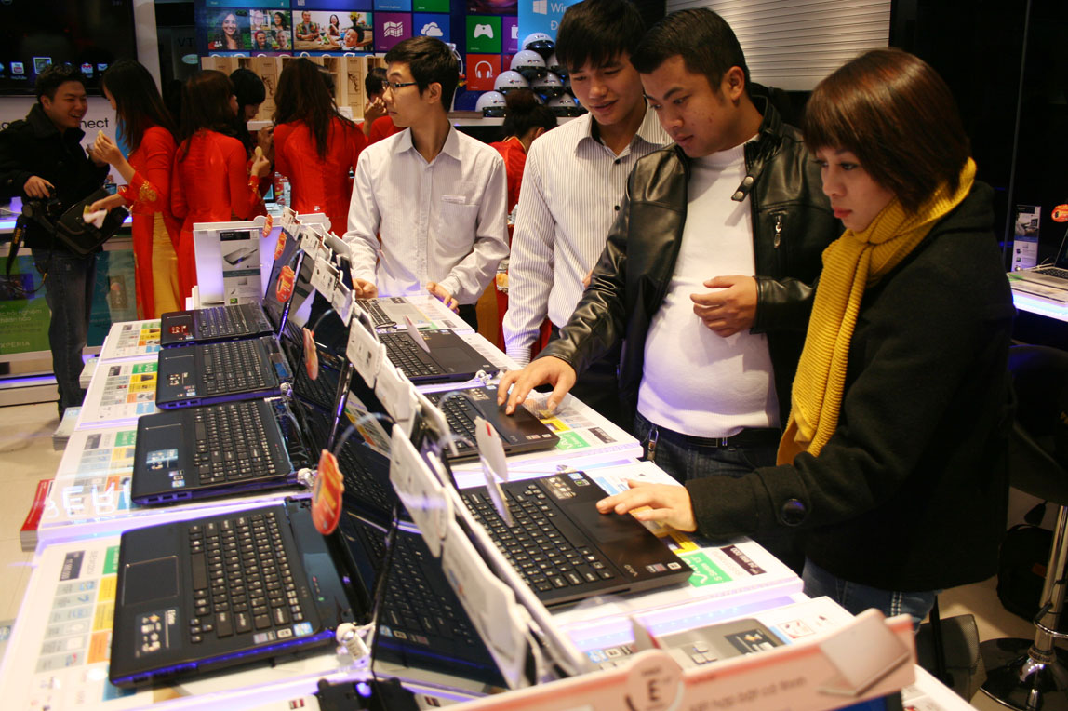
Scenario problem
!!!...
???...

Slide 5
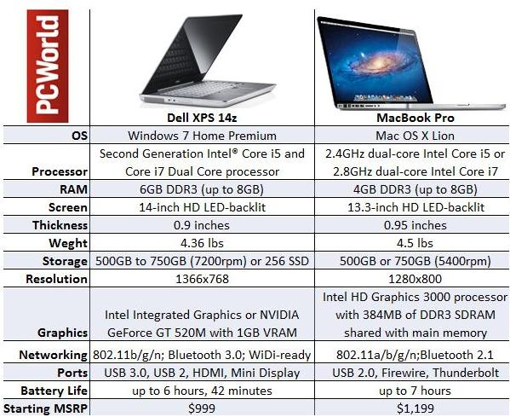
Scenario problem

Slide 6
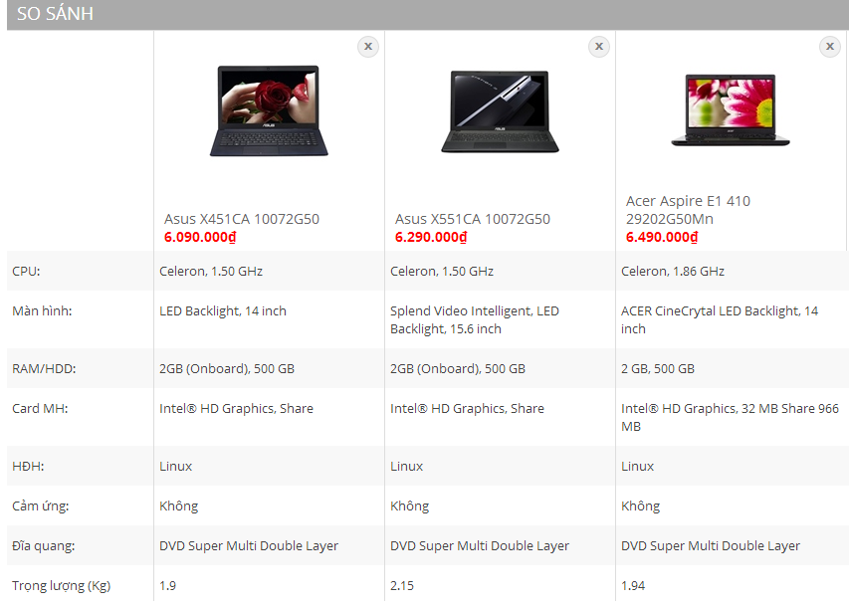

Scenario problem

Slide 7

Scenario problem

Slide 8






Scenario problem
Search
Add to compare
Detail
Detail
Make Decision
Make Decision
Calculate point from another compare hardware website

Slide 9
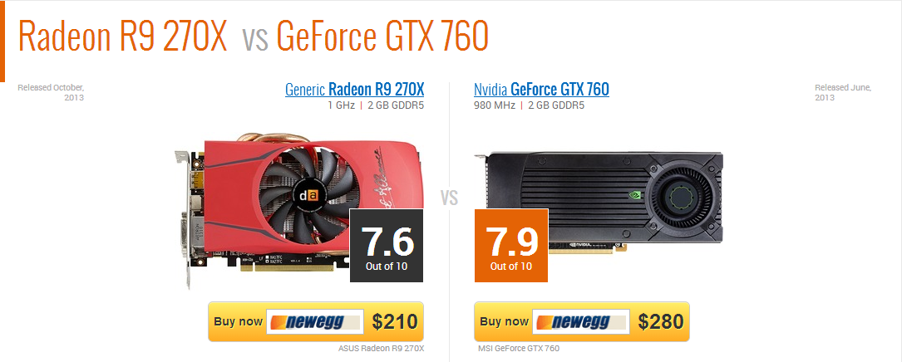

Scenario problem
http://gpuboss.com/gpus/Radeon-R9-270X-vs-GeForce-GTX-760
http://cpuboss.com/cpus/Intel-Core-i7-4790-vs-Intel-Core-i7-4770

Slide 10
Scenario problem
Text Blank all descriptions about laptop are always blanks.
1

Slide 11
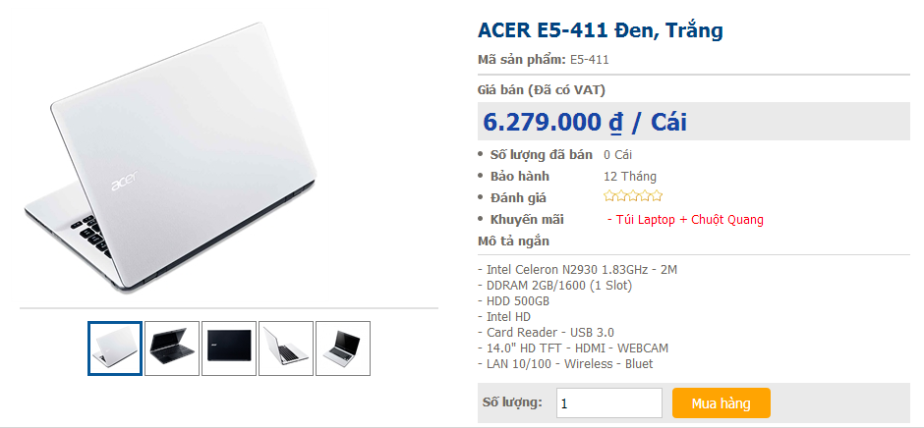
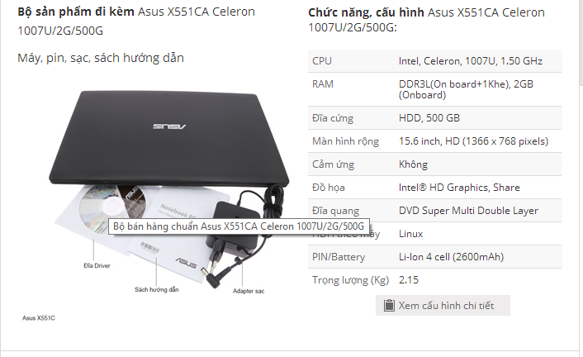
Scenario problem
Limitations We just can focus on 1 website at 1 time for comparing in that website.
2

Slide 12

Scenario problem
Rating system Do not have any rating laptop system in Vietnam.
3

Slide 13
Scenario problem
All of these Disadvantages will make customer to feel confuse when they want to buy laptop but don’t know which one is better than others.
1
2
3

Slide 14
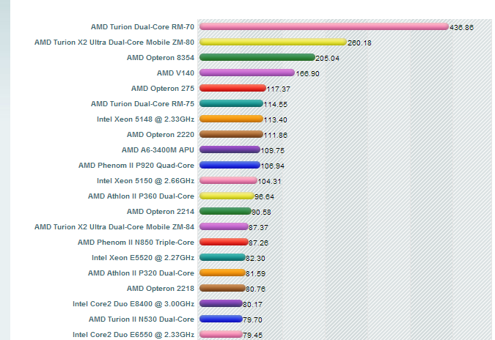



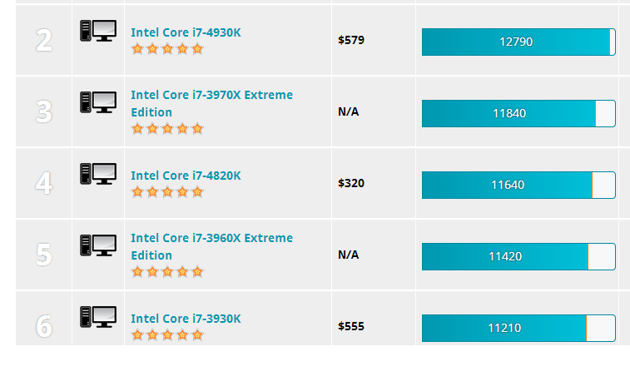
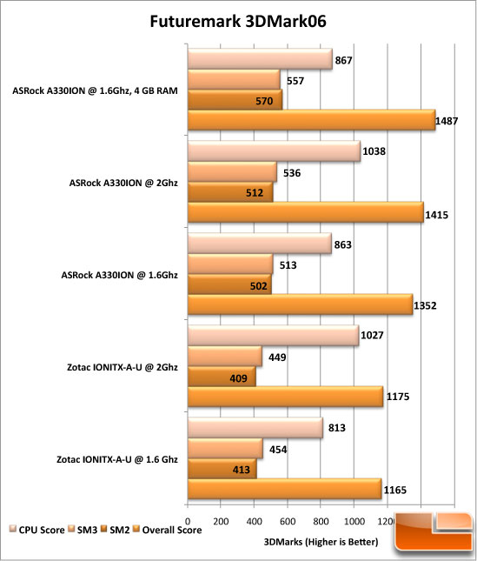

Our idea: collect data
Collect Data

Slide 15





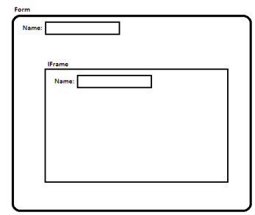
Our idea: collect data by parsing
Take link
Download
Remove Script
Load
Inspect
Display

Slide 16
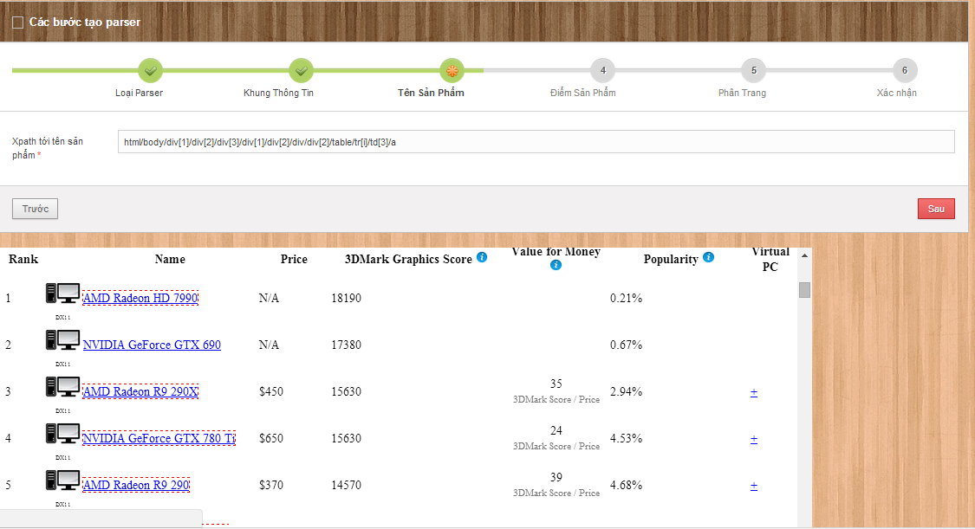
Our idea: collect data by parsing

Slide 17
Our idea: collect data by parsing
Step 1-From Clicked Node
Step 2-Get Parent “table” Node
Step 3-Get All Child Node
Step 4-Stop When Meet “HTML Node”Or Meet “ID”
Step 5-Take XPath
Step 6-Get Data

Slide 18
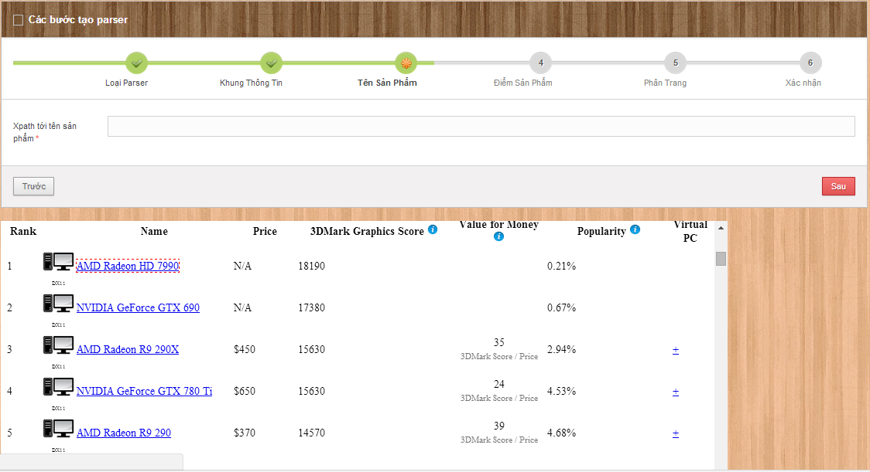
Step: 1&2 GET clicked node and get parent “TABLE” node
1-html/body/div[1]/div[2]/div[3]/div[1]/div[2]/div/div[2]/table/tr[1]/td[3]/a
2-html/body/div[1]/div[2]/div[3]/div[1]/div[2]/div/div[2]/table/tr[2]/td[3]/a
3-html/body/div[1]/div[2]/div[3]/div[1]/div[2]/div/div[2]/table/tr[3]/td[3]/a
4-html/body/div[1]/div[2]/div[3]/div[1]/div[2]/div/div[2]/table/tr[4]/td[3]/a
5-html/body/div[1]/div[2]/div[3]/div[1]/div[2]/div/div[2]/table/tr[5]/td[3]/a
html/body/div[1]/div[2]/div[3]/div[1]/div[2]/div/div[2]/table/tr[i]/td[3]/a

Slide 19

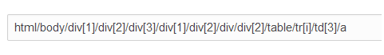
Step 3&4: GET all child node and stop when meet “HTML” NODE, meet “ID”

Slide 20
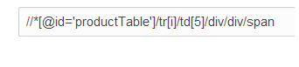
Step 5&6: Take Xpath and get data
AMD Radeon HD 7990: 18190
NVIDIA GeForce FTX 690: 17380
AMD Radeon R9-290x : 15630
NVIDIA GeForce GTX 780: 15630
AMD Radeon R9 290: 14570
Product Name Xpath
Product Point Xpath

Slide 21
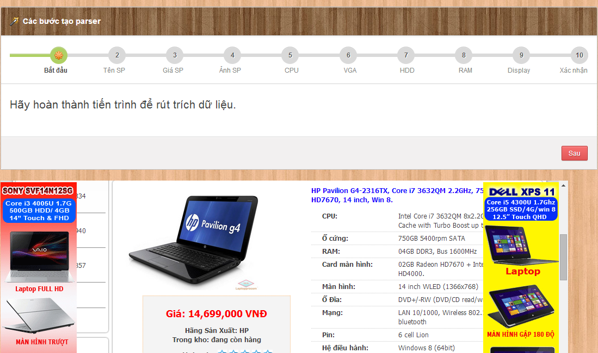
Our Ideas: Take laptop hardware's - Option 1

Slide 22
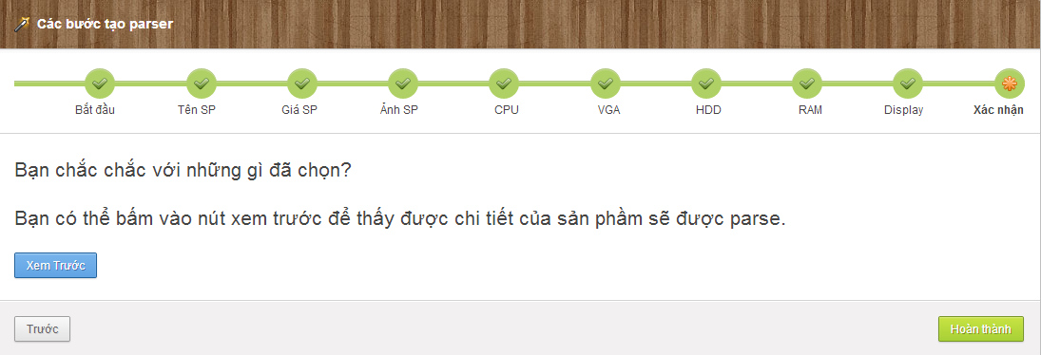
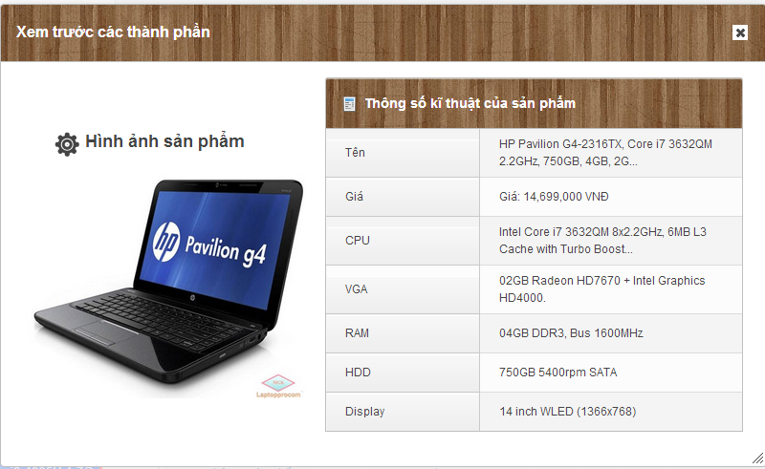
Our Ideas: Take laptop hardwares - Option 1
Name Xpath: //*[@id='pro_detail']/div/div/div[2]/div/div[1]/p
…
Display Xpath: //*[@id='pro_detail']/div/div/div[2]/div/div[5]/p

Slide 23
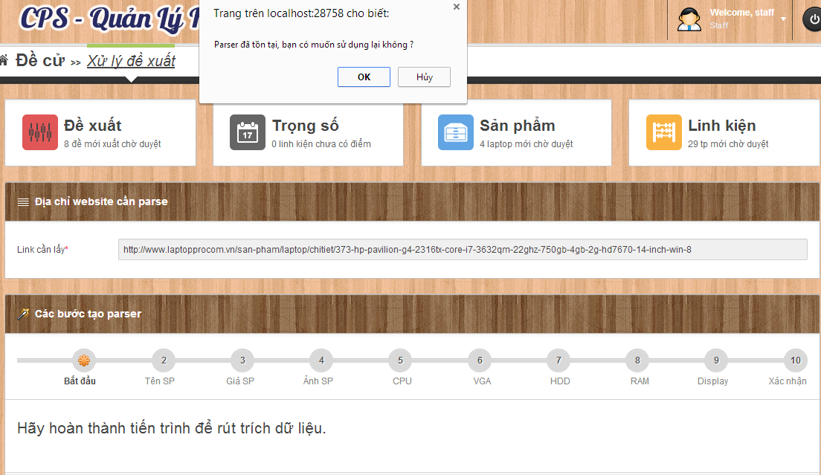
Our Ideas: Take laptop hardware's - Option 2
Auto Parse base on Existed parser
Return Option 1

Slide 24




Our idea: build data system
Build Data System

Slide 25





Our idea: build data system
New Laptop
Data Object
Database
Is New
False
True
Notes:
Hệ thống em insert 1 laptop mới và matching với 1 sản phẩm có sẵn trong database.

Slide 26

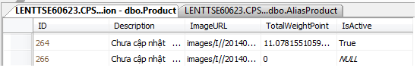
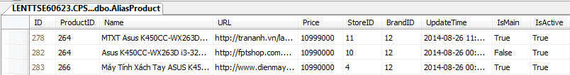
Our idea: build data system
Mapping
Data Object
New
MTXT Asus
K450CC-WX263D màu xám
Máy Tính Xách Tay ASUS
K450CC-WX263D (GRAY)
Notes:
264 có thêm 1 tên phụ.

Slide 27

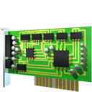






Our idea: build data system
Compare (80%<a<100%)
Compare (a =100%)
True
False
Join
True
False
Split
Mapping

Slide 28
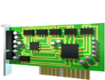
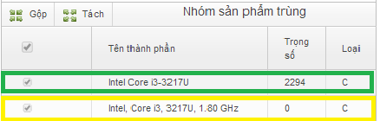
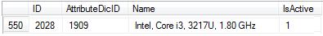
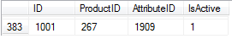
Our idea: build data system
Data Object
Compare
87%
Intel, Core i3, 3217U, 1.80 GHz
Intel Core i3-3217U 1.80 GHz
Intel Core i3-3217U
Laptop Id
Hardware in database
New hardware
Table: Dictionary
Table: ProductAttribute

Slide 29

Our idea: publish to user
Go Online

Slide 30


summary

Slide 31



Problem solution: example problem
Give 2 laptops, find out the best of them.
HP PAVILION 14 N237TU
ACER ASPIRE E1 470G

Slide 32

Problem solution
Determine 5 types of laptop’s hardware which are the most customer will be interested in when choosing a laptop.
Chipset (CPU)
Graphic card (VGA)
Memory (RAM)
Hard disk (HDD)
Screen solution
http://bit.ly/cps-survey-summary

Slide 33
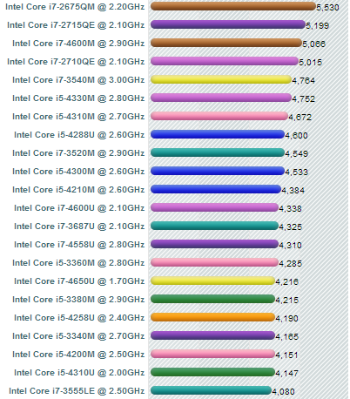
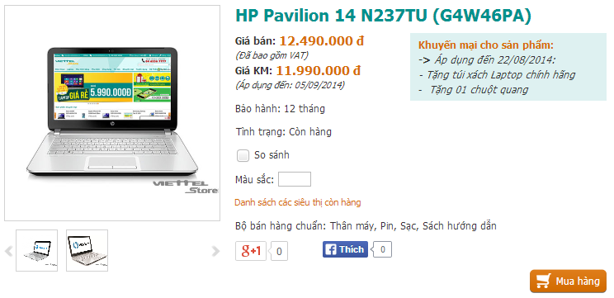
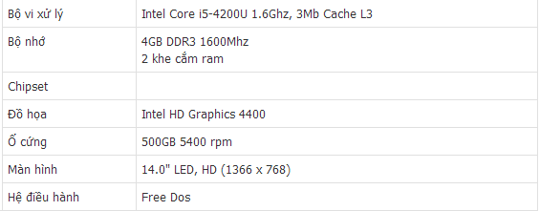



Problem solution: collect data
Laptop’s Hardwares
Laptops
cpubenchmark.net
viettelstore.vn
Notes:
Tách thành 2 slide

Slide 34


Problem solution: reduce score
 | HP PAVILION 14 N237TU | ACER ASPIRE E1 470G
Chipset (CPU) | 3293 | 2294
Graphic card (VGA) | 600 | 1070
Memory (RAM) | 4 | 2
Hard disk (HDD) | 500 | 500
Screen solution | 14 | 14

Slide 35
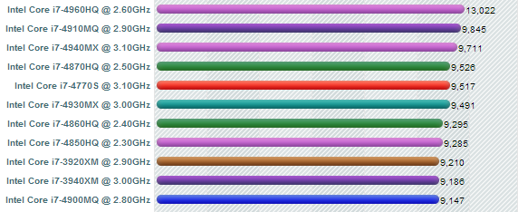
Problem solution: reduce score
➢ Reduce hardware’s score on the scale from 1 to 100
➢ Define:
x = Highest hardware’s score.

Slide 36
Problem solution: reduce score
➢ Reduce hardware’s score on the scale from 1 to 100
➢ Define:
x = Highest hardware’s score.
y =
Hardware’s score which will reduce.
3293

Slide 37
Problem solution: reduce score
➢ Reduce hardware’s score on the scale from 1 to 100
➢ Define:
x = Highest hardware’s score.
y =
Hardware’s score which will be reduced.
h = Hardware’s score on the scale from 1 to 100.
☞

Slide 38

Problem solution: reduce score
 | HP PAVILION 14 N237TU | ACER ASPIRE E1 470G
Chipset (CPU) | Intel Core i5-4200U | Intel Core i3-3217U
Hardware’s score | 3293 | 2294
Highest hardware’s score | 13022 | 13022
2Score on the scale from 1 to 100
Chipset’s score

Slide 39
Problem solution: reduce score
 | HP PAVILION 14 N237TU | ACER ASPIRE E1 470G
Video card (VGA) | Intel HD Graphic 4400 Mobile | NVIDIA GeForce GT 720M
Hardware’s score | 600 | 1070
Highest hardware’s score | 18190 | 18190
Score on the scale from 1 to 100
Video card’s score

Slide 40
Problem solution: reduce score
Hardware’s score
on the scale
from 1 to 100
 | HP PAVILION 14 N237TU | ACER ASPIRE E1 470G
Chipset (CPU) | 24.95 | 17.38
Graphic card (VGA) | 3.30 | 5.88
Memory (RAM) | 25 | 12.5
Hard disk (HDD) | 12.5 | 12.5
Screen solution | 80.92 | 80.92

Slide 41
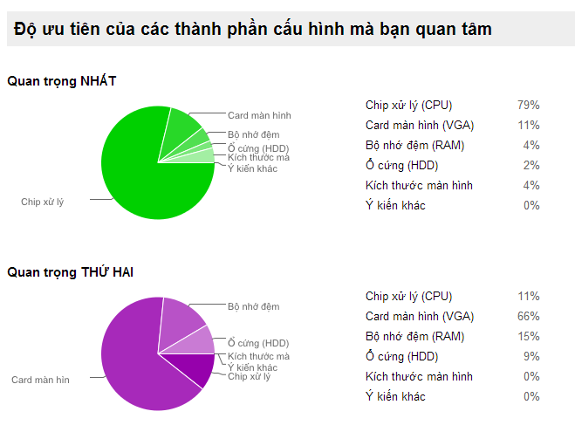
Problem solution: priority coefficient
http://bit.ly/cps-survey-summary

Slide 42
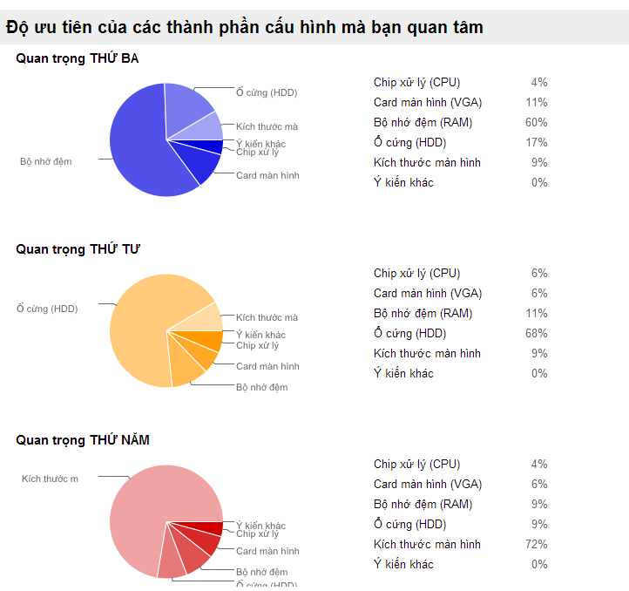
Problem solution: priority coefficient
http://bit.ly/cps-survey-summary

Slide 43
Problem solution: calculate product’s score
Hardware’s name | Score
Chipset (CPU) | c
Graphic card (VGA) | v
Memory (RAM) | r
Hard disk (HDD) | h
Screen solution | s
☞

Slide 44
Problem solution: calculate product’s score
HP PAVILION 14 N237TU
ACER ASPIRE E1 470G

Slide 45
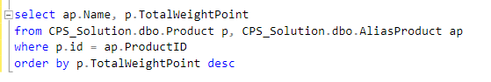
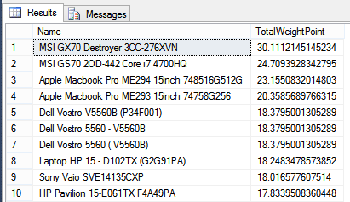
Problem solution: reduce score
Get highest product’s score in database

Slide 46
Problem solution: reduce score
 | HP PAVILION 14 N237TU | ACER ASPIRE E1 470G
Product’s score | 12.86 | 11.26
Highest product’s score | 30.11 | 30.11

Slide 47
Problem solution: reduce score
➢ Reduce hardware’s score on the scale from 1 to 100
➢ Define:
P = Highest product’s score.
p =
Product’s score which will be reduced.
p’ = Product’s score on the scale from 1 to 100.
☞

Slide 48
Problem solution: reduce score
Product’s score
on the scale
from 1 to 100
 | HP PAVILION 14 N237TU | ACER ASPIRE E1 470G
Product’s score | 12.86 | 11.26
Highest score in the database | 30.11 | 30.11
Score on the scale from 1 to 100

Slide 49
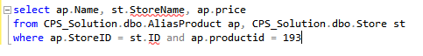
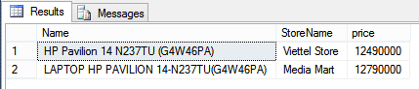
Problem solution: calculate price/score
Get all product’s price from stores of a product.
Min Price
Max Price

Slide 50
Problem solution: calculate price/score
➢ Define:
P_{min/max} = Min/Max price of a product
S =
Product’s score
R_{min/max} = Min/Max price for each product’s score
☞

Slide 51
Problem solution: calculate price/score
 | HP PAVILION 14 N237TU | ACER ASPIRE E1 470G
Product’s min price (VNĐ) | 12.490.000 | 8.990.000
Product’s max price (VNĐ) | 12.790.000 | 8.990.000
Product’s score | 12.86 | 11.26
Min Price for each score (VNĐ)
Max Price for each score (VNĐ)
Price for each score

Slide 52

Problem solution: compare
Product’s score on the scale from 1 to 100
Min/Max price of each product’s score

Slide 53
Features
Search
Smart
Compare
Recommend
Product
Suggestion
Import Excel
Get data from web
Training System

Slide 54

demonstration

Slide 55



Story board
 | Guest
 | Member
 | Staff

Slide 56



Demo scenario: guest
Search product
Add to cart
View compare

Slide 57





Demo scenario: member
Search product by Price
View Compare
Search Not Found
View Details
Recommend

Slide 58

Demo scenario: staff
Train machine
Get data from web

Slide 59
Advantages AND Disadvantages
Advantages
Suggestion
Training System
Disadvantages
Staff spend time for training
Not support mobile version
Many Resources
Smart Compare
Not provide Payment Method
Staff must have knowledge about hardware

Slide 60


Future plan
Optimize algorithm
Build mobile application

Slide 61
Q&A

Slide 62
Thank You !

Slide 63
String Comparisons

Slide 64
Define Problem
Given 2 strings. Calculate their matching percent.
First String | Second String | Result (percent)
Healed | Sealed | 80
Healed | Healthy | 55
Healed | Heard | 44
Healed | Herded | 40
Healed | Help | 25
Healed | Sold | 0

Slide 65
Requirement
A robustness to changes of word order: two strings which contain the same words, but in a different order, should be recognised as being similar.
Language independence: the algorithm should work not only in English, but in many different languages.

Slide 66
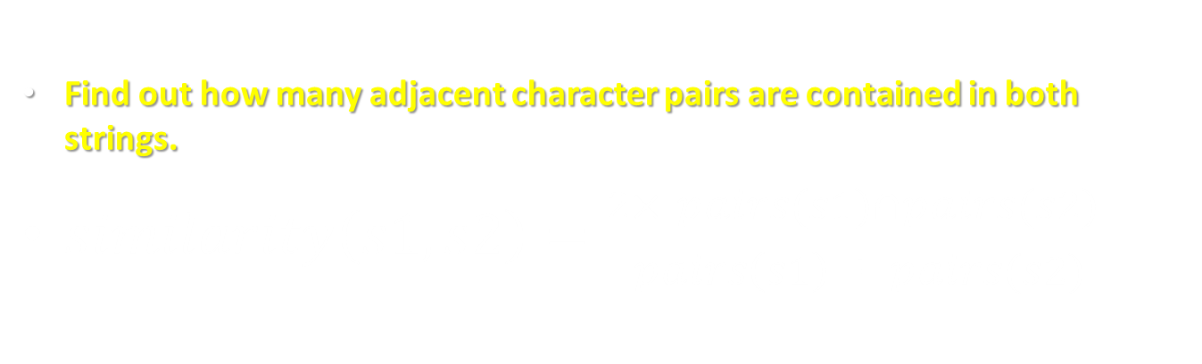
Solution
Find out how many adjacent character pairs are contained in both strings.
$similarity\left(s1,s2\right)=\frac{2×\left|pairs(s1)∩pairs(s2)\right|}{\left|pairs\left(s1\right)\right|+\left|pairs(s2)\right|}$

Slide 67
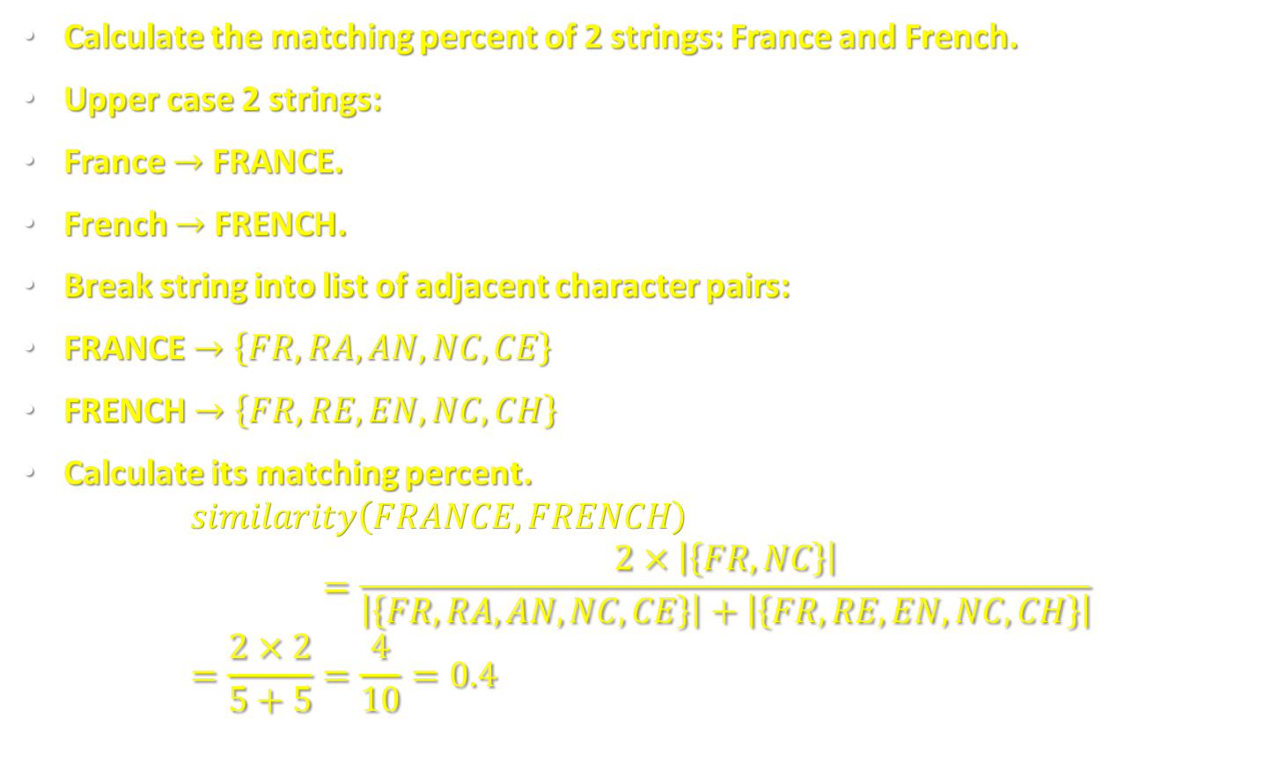
Example
Calculate the matching percent of 2 strings: France and French.
Upper case 2 strings:
France $→$ FRANCE.
French $→$ FRENCH.
Break string into list of adjacent character pairs:
FRANCE $→\left\{FR,RA,AN,NC,CE\right\}$
FRENCH $→\left\{FR,RE,EN,NC,CH\right\}$
Calculate its matching percent. $similarity\left(FRANCE,FRENCH\right)=\frac{2×\left|\left\{FR,NC\right\}\right|}{\left|\left\{FR,RA,AN,NC,CE\right\}\right|+\left|\left\{FR,RE,EN,NC,CH\right\}\right|}$ $=\frac{2×2}{5+5}=\frac{4}{10}=0.4$

